Slide 1
Baking Marketplace Project Proposal
Andrew Spence (300383703)

Slide 2

Home Page

Slide 3

Menu Page

Slide 4
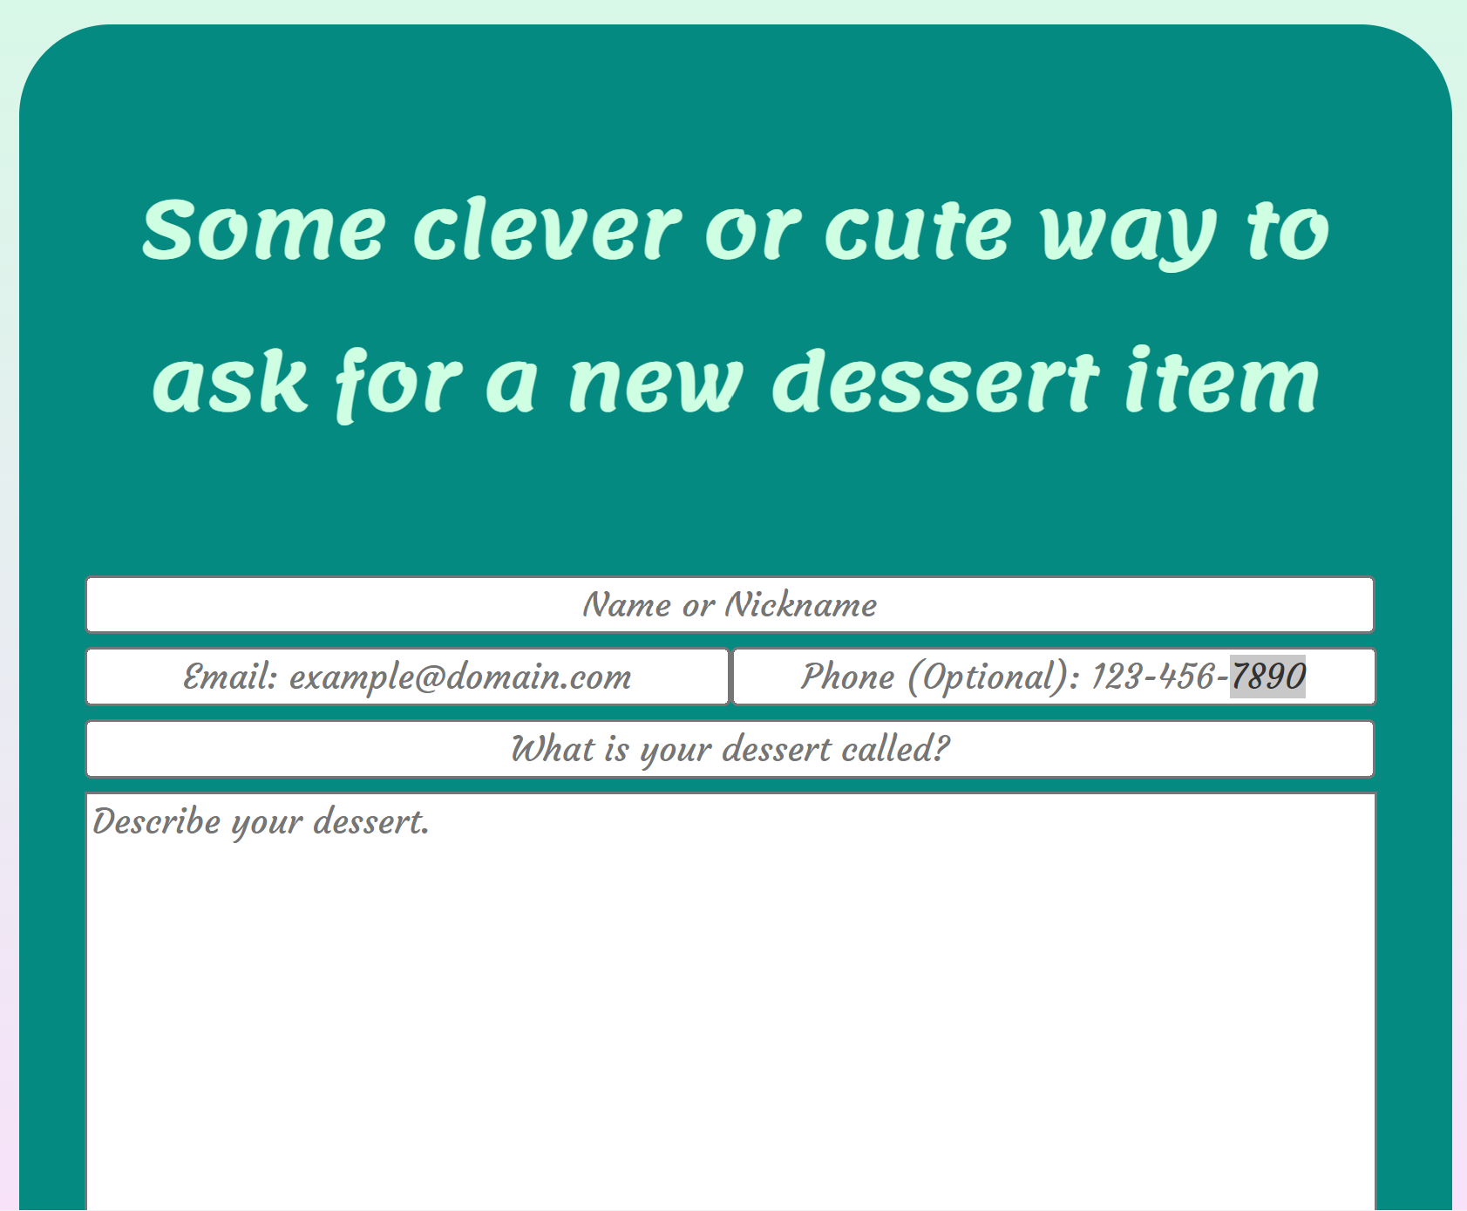

Special Requests & Catering

Slide 5


Profile & Contact

Slide 6
Future Features
Responsive Design
Emailing Functionality
Order Storage & Accounts
Animations
Blog Wall
Cart

